Slide 1
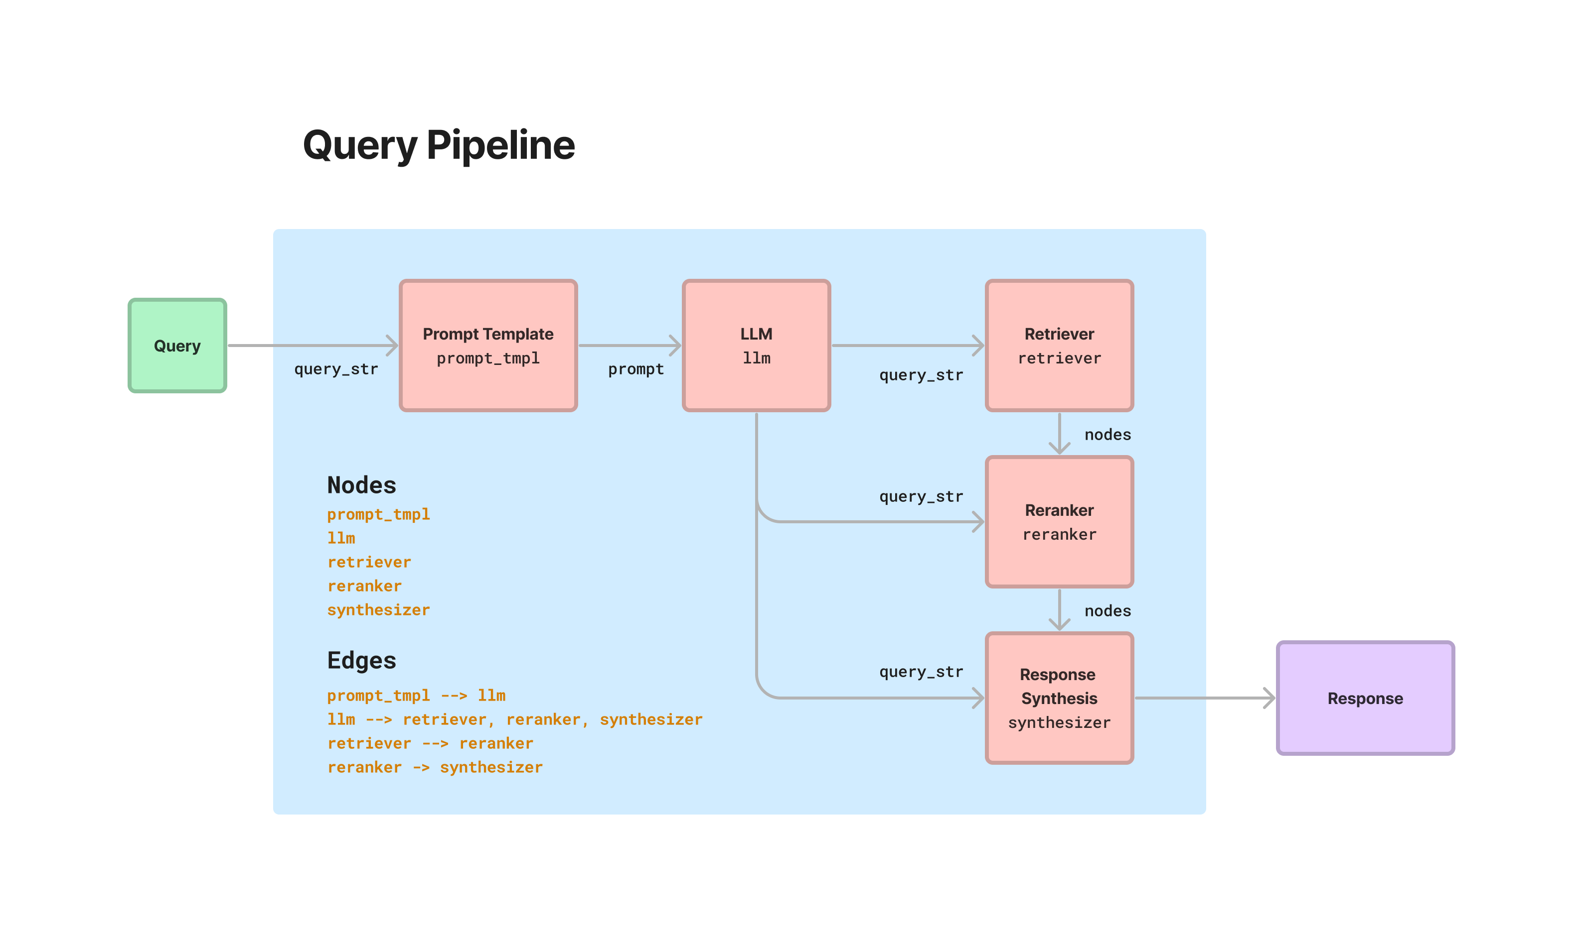
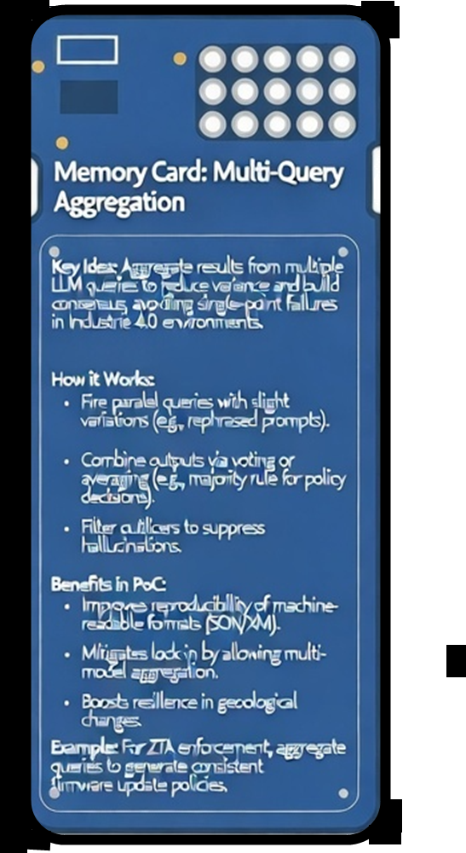
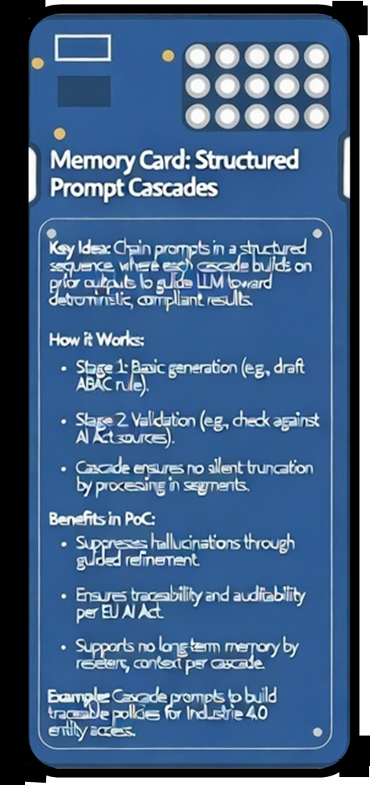
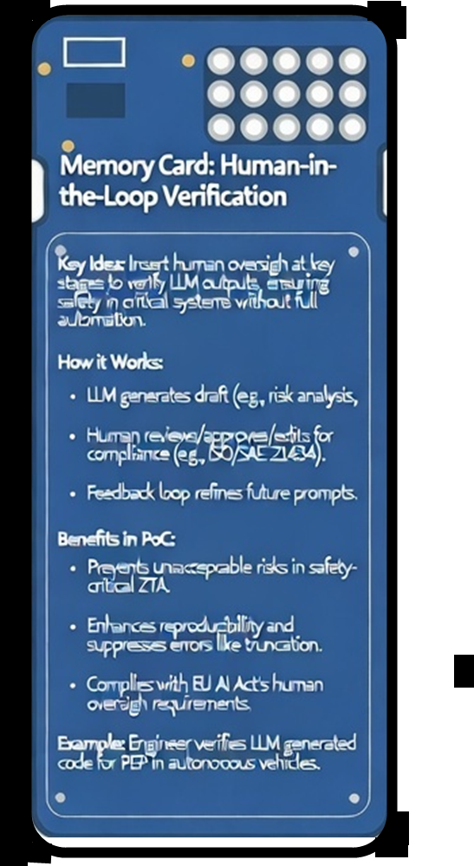
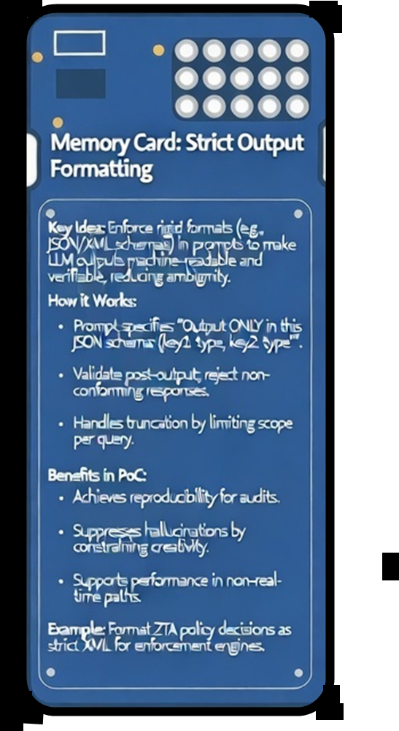
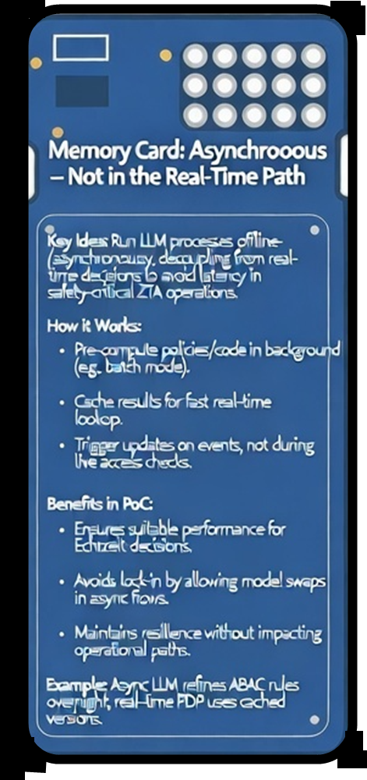
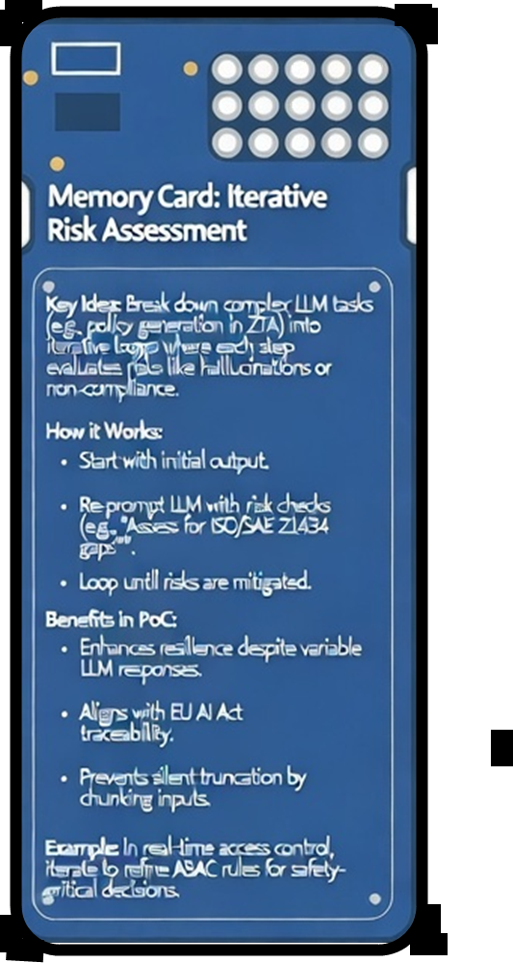


Our proof-of-concept approach
Prompt
We propose:
Multi-stage LLM-driven framework
No "one-shot prompting,„
but rather:
Iterative risk assessment
Multi-Query Aggregation
Structured prompt cascades
Human-in-the-loop verification
Strict output formatting
Asynchronous – not in the real-time path.
IEEE Webinar “Mind the Gaps”, 2026-03-04

Slide 2
Architecture overview
Stage 1 – Risk analysis
Threat model
Compliance comparison (e.g., EU AI Act)
Stage 2 – Policy Generation
ABAC rules
Explicit attribute definition
Constraint checking
Stage 3 – Code generation
Formally structured output
Machine-readable format
Deterministic templates
Stage 4 – Verification
Human review loop
Cross-model validation
TBD
IEEE Webinar “Mind the Gaps”, 2026-03-04

Slide 3
Why asynchronous?
Important:
❌ No LLMs in the real-time access path ✔ Only for development and policy engineering
This results in:
No latency issues
No safety risk
Better auditability
IEEE Webinar “Mind the Gaps”, 2026-03-04

Slide 4
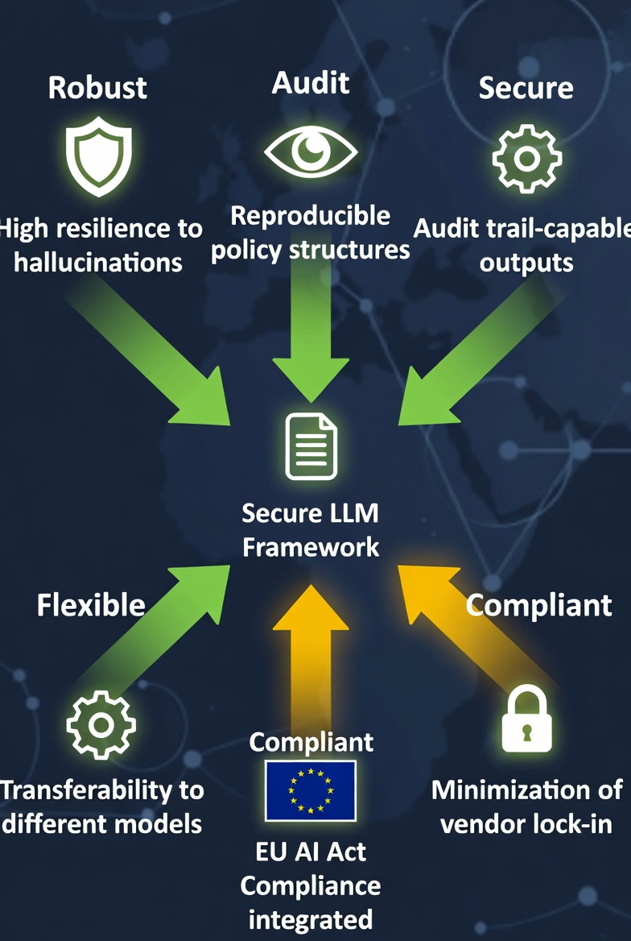
Results of the proof of concept
We were able to demonstrate:
High resilience to hallucinations
Reproducible policy structures
Audit trail-capable outputs
Transferability to different models
Minimization of vendor lock-in
Particularly important:
EU AI Act compliance can be integrated.
IEEE Webinar “Mind the Gaps”, 2026-03-04

Slide 5
Development trends
We expect:
Software-defined vehicles
Cross-company data ecosystems
Automated compliance checks
AI-supported policy orchestration
LLMs will not only write code, but also:
support policy lifecycle management.
IEEE Webinar “Mind the Gaps”, 2026-03-04

Slide 6
Possible further developments
Combination with formal verification methods
Integration into CI/CD pipelines
Hybrid models (LLM + symbolic engines)
Standardization in automotive data spaces
Certifiable AI-assisted engineering processes
IEEE Webinar “Mind the Gaps”, 2026-03-04

Slide 7
Risks of the future
If used without control:
Non-transparent policy logic
Non-deterministic systems
Regulatory blockages
Loss of trust in AI systems
The question is not:
whether we use LLMs
but:
how we structure and control them.
IEEE Webinar “Mind the Gaps”, 2026-03-04

Slide 8
Recommendation for industry & research
1️⃣ Only use LLMs in the engineering layer
Not in the enforcement layer.
2️⃣ Multi-stage instead of one-shot
No direct code prompts without risk analysis.
3️⃣ Human-in-the-loop mandatory
Especially for safety-critical systems.
4️⃣ Enforce strict output formats
Machine-readable policies instead of continuous text.
5️⃣ Auditability as a design principle
Every prompt = traceable artifact.
IEEE Webinar “Mind the Gaps”, 2026-03-04

Slide 9
Key message
LLMs are not a substitute for security engineering.
But when used in a structured way, they can be a powerful tool.
Our proof of concept shows that
✔ Robustness is possible ✔ Compliance can be integrated ✔ Safety remains unaffected ✔ Developer pitfalls are manageable
IEEE Webinar “Mind the Gaps”, 2026-03-04

Slide 10
Thank you very much!
IEEE Webinar “Mind the Gaps”, 2026-03-04
Discussion questions:
How do we standardize LLM-based policy generation?
Do we need regulatory guidelines for AI-assisted engineering?
How do we combine formal methods with generative AI?
Thomas Walloschke thomas.walloschke@secon-tc.eu
Dr. Michael Schmitt m.schmitt@sap.com

